Slide 1


Avanza Solutions.
Information Security Project Presentation
Group Members:
Ahmed Memon
Usaid Bin Rehan
Mukand Krishna
Get Started

Slide 2

About Avanza Solutions
Digital Technology and Automation
Avanza Solution Serves as a digital hub of innovation and digitalization where technologies like Customer Experience, Artificial Intelligence, Blockchain, Channel Banking, Smart City applications, Business Automation, and Cognitive platforms are developed, deployed, and integrated.
500+
700M
Product Deployments
Interactions Daily
45+
500+
Countries
Professionals

Slide 3




Avanza Solutions/Services
Some highlights among Avanza Solutions' comprehensive range of services, there are many more innovative solutions they offer.
Digital Banking
Internet and Mobile Banking
social and bot-based banking, digital onboarding, e-wallets, middleware platform, connecting systems
Ambit, an advanced internet and mobile banking platform. It provides an intuitive online banking experience
Omni & ATM Experience
Digital Business
Novus Xcite, revolutionizing ATM and CDM interactions. UI/UX designs and improves customer loyalty.
Maverick stands out as an OpenAPI platform, promoting Open Banking, Investment and Wealth Management Solution

Slide 4

Methodology: Assessing Cyber Security Posture
Purpose
Utilized 70-question assessment framework to identify vulnerabilities , assess potential risks and understrand state of cybersecurity defenses
Outcome:
Assessment conducted by surveying relevant personnel.
Findings provided overview of cybersecurity strenghts and areas needing improvement.
Important to develop targeted risk mitigation strategies

Slide 5

Key Observations - 1
Cyber Security Training and Awareness
Limited Cyber Security awareness and training among end-users.
Inconsistent Application of secure password storage training.
Reporting procedures for suspicious activities lack clarity

Slide 6
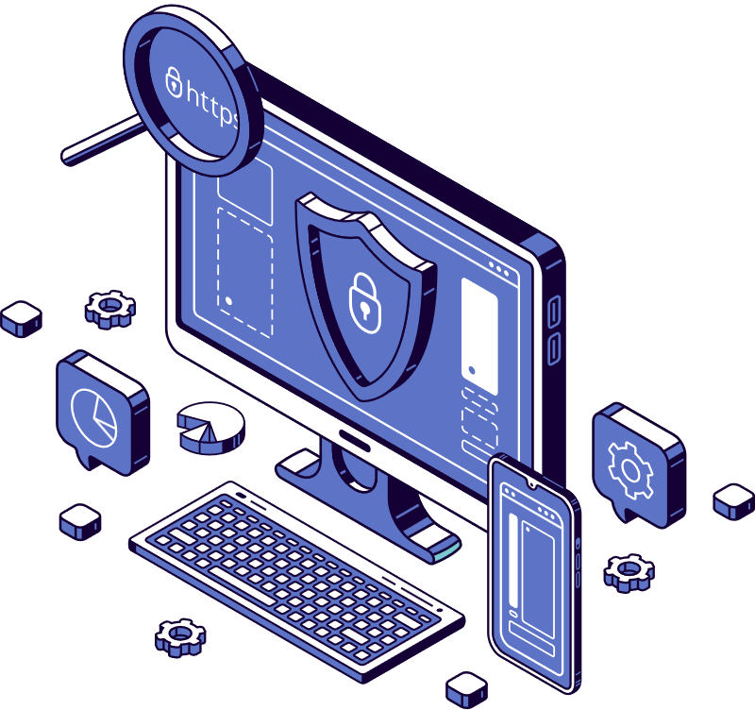
Key Observations - 2
Access Control and Account Management
Inconsistencies in changing or disabling default vendor accounts.
Challenges in enforcing strict password and passphrase policies.
Delays in deactivating user accounts upon termination of employment..

Slide 7

Key Observations - 3
End User and Endpoint Security
Limited tools for end-user password management.
Non-uniform password policy enforcement.
Challenges in integrating advanced threat intelligence.
Limited implementation of next-generation anti-malware protection.
Challenges with personal firewalls and uniform antivirus implementation.

Slide 8

Key Observations - 4
Event Management and Security Architecture
Variability in log storage and review practices.
Constrained incident response capabilities.
Challenges in access control and enforcing least privilege.
Limited deployment of zero-trust models and multifactor authentication.

Slide 9
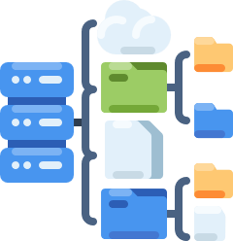
Key Observations - 5
Incident Response, Inventory, and Data Management
Limited incident response planning and practice.
Challenges in maintaining complete asset inventories.
Varied practices in data flow management and file integrity monitoring.
Challenges in data classification and loss prevention.

Slide 10
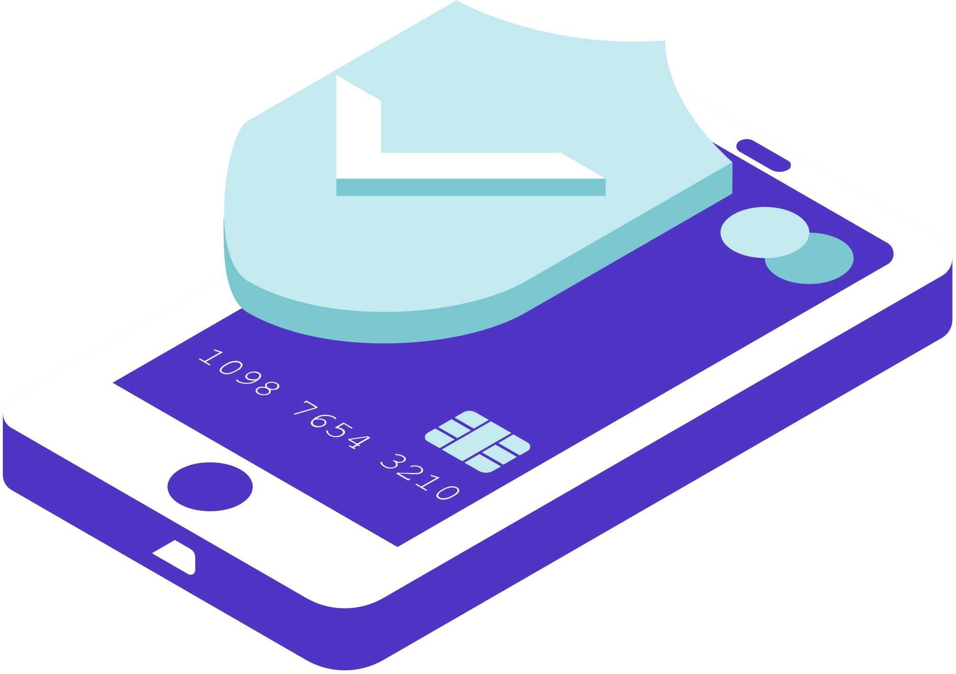
Key Observations - 6
Software Development and Mobile Device Management
Limited secure software development practices.
Challenges in adopting software engineering techniques for vulnerability mitigation.
Ongoing challenges in web application security.
Variability in mobile device management and control.

Slide 11

Proposed Mitigation
Strategies - 1
01.
Implement comprehensive and frequent cybersecurity training programs.
02.
Conduct regular phishing simulation exercises.
03.
Clarify and simplify the procedures for reporting suspicious activities.
Enhancing Cybersecurity
Training

Slide 12

Proposed Mitigation
Strategies - 2
01.
Automate the process of disabling accounts post-employment.
02.
Regularly review and enforce password policies.
03.
Update and standardize procedures for vendor account management.
Strengthening Access Control

Slide 13
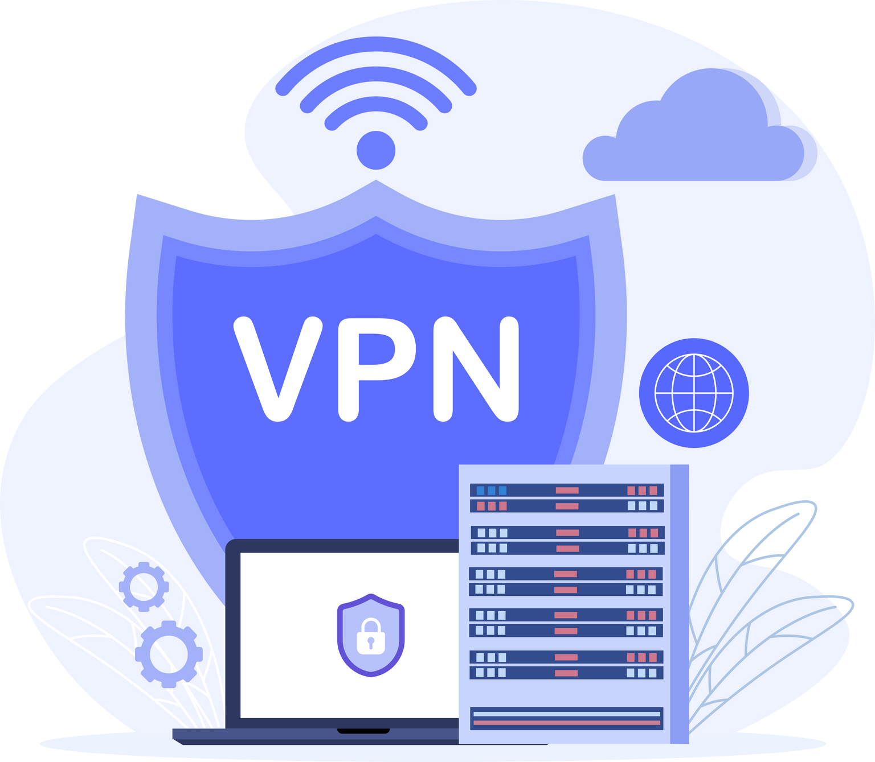
Proposed Mitigation
Strategies - 3
01.
Integrate advanced threat intelligence solutions into endpoint security.
02.
Ensure uniform deployment of next-generation anti-malware software.
03.
Standardize log storage durations and review processes.
Upgrading Endpoint Security

Slide 14

Proposed Mitigation
Strategies - 4
01.
Foster shared responsibility in security system design.
02.
Apply design principles like threat modeling, least privilege, and defense in depth.
03.
Focus on cloud security and infrastructure protection.
Enhancing Security Architecture and Engineering

Slide 15
Proposed Mitigation
Strategies - 5
01.
Enhance training and awareness programs.
02.
Develop robust reporting, intrusion detection, and incident management systems.
03.
Implement playbooks and post-breach forensics for comprehensive response.
Strengthening Security Operations

Slide 16

Proposed Mitigation
Strategies - 6
01.
Adopt secure programming practices and guidelines.
02.
Integrate security into each element of the software development life cycle.
03.
Perform application security tests to ensure vulnerabilities are mitigated.
Advancing Software Development Security

Slide 17

Conclusion
Securing Our Digital Future
Identified areas in cybersecurity requiring immediate attention, spanning from training and access control to endpoint security and software development.
Assessment highlights:
incorporating robust risk management,
secure architecture
comprehensive security operations.

Slide 18

THANK YOU!
Get protected today!

